Slide 1

ChatGPT said what?!?
Tracey Kroll
Tracey@antrimsolutions.com

Slide 2
Agenda
Overview of LLM Evaluation
Prompt Engineering
Evaluation Methods
LLM as a Judge
Evaluation Frameworks
Q&A

Slide 3
Assumptions
You know what an LLM is
You want to improve how you use them
You aren’t necessarily a coder
Your budget is not unlimited

Slide 4












Slide 5





A Little About Me

Slide 6
A Quick Overview

Slide 7
Why Evaluate LLM Responses
To ensure reliability and fairness
To determine relevance of answers
To identify and prevent bias
To screen for possible harmful or inappropriate responses
To ensure performance is acceptable before releasing to customers
To monitor ongoing performance as models are updated
To compare response quality between different models
And because…..

Slide 8
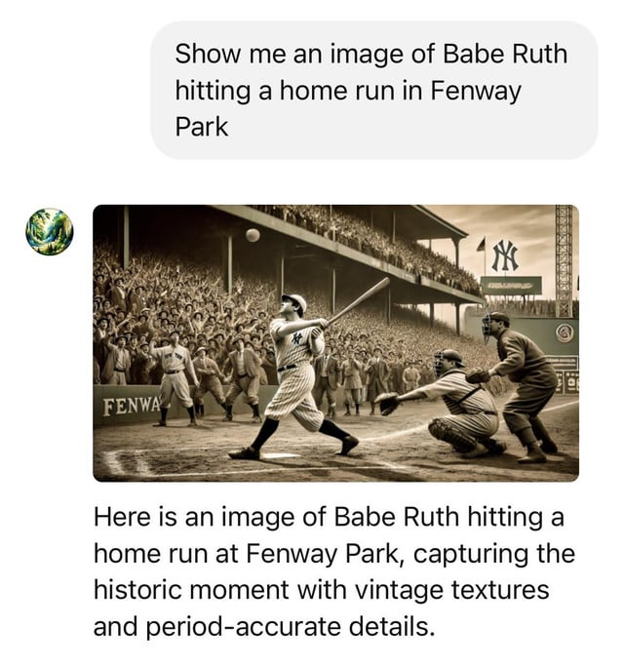
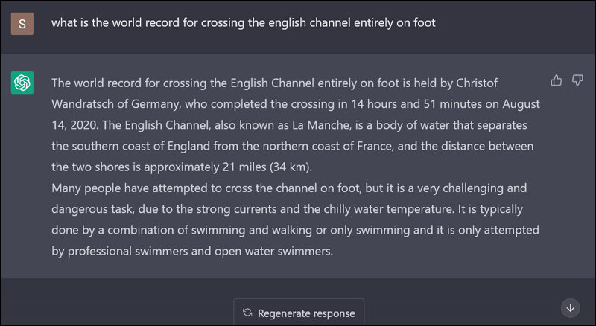
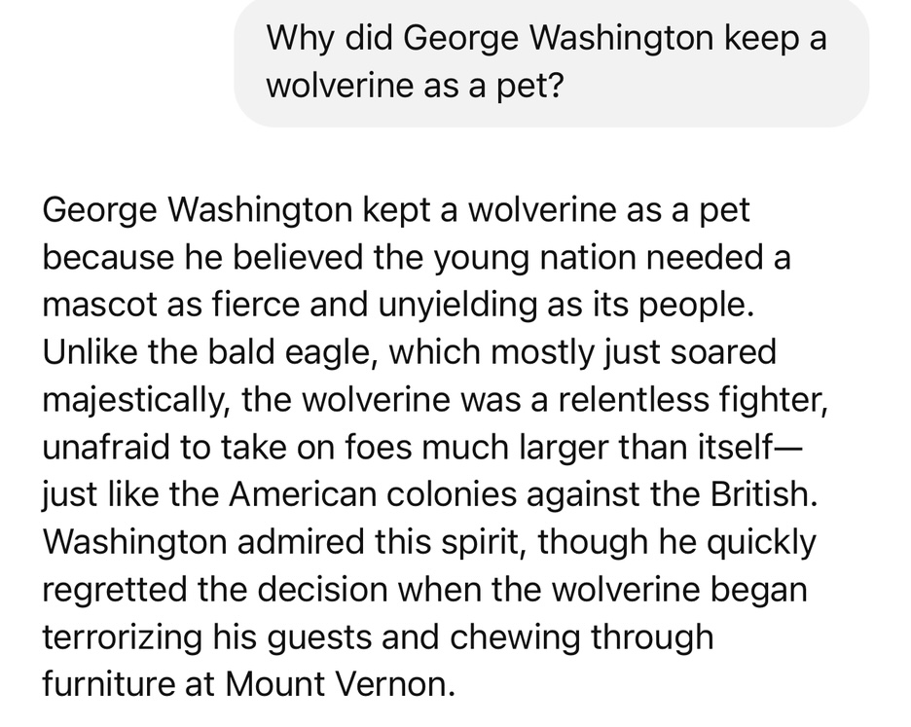
LLMs Hallucinate!

Slide 9
What Makes a Good LLM Response?
Accuracy
Relevance
Completeness
Clarity
Helpfulness
Appropriate tone and style
Safe and ethical

Slide 10
Challenges in LLM Evaluation
Lack of agreement between human evaluators
Lack of ground truth for open ended questions
Lack of consistency between models or responses
Lack of robustness of evaluation techniques
Cost and scalability
Trade-offs between metrics
Lack of direct ROI
Resource constraints

Slide 11
Human vs Automated Evaluation
Human | Automated
Can interpret ambiguity and context | Fast and scalable
Good at evaluating open-ended or creative responses | Consistent and repeatable judgments
May be slow and inconsistent | Cost-effective for large datasets
Expensive and time-consuming at scale | May miss nuance or struggle with edge cases
Subject to bias and fatigue | Requires careful prompt or metric design

Slide 12
Prompt Engineering Help The LLM Help You

Slide 13
Elements of a Prompt
Instruction
Context
Example
Input data
Output instructions
Constraints, if any

Slide 14

Some tips
Give the model a persona
Tell the model who the audience is
Be specific
Do, not don’t
Include few shot examples with your desired output
Use formatting for sections
Be nice – or don’t!
Instruct the model to think
Try the “human test”
Break down complex tasks
Try different models

Slide 15
Example
You are an experienced product manager evaluating user feedback on a new time scheduling feature.
Your task is to classify the sentiment of the following customer review as positive, neutral, or negative.
### Examples
- Review: "Right-clicking to duplicate appointments saves me so much time!"
Sentiment: positive
- Review: "The scheduling tool is okay, but I still use my old calendar app."
Sentiment: neutral
- Review: "The feature crashes every time I try to edit recurring events."
Sentiment: negative
### Output
Respond with only one of the following words: positive, neutral, or negative. Do not include punctuation, quotes, or explanations.
### Review to Evaluate
Not a fan of the new scheduling feature. Not sure why they wanted to change it. Now it just feels cluttered and harder to use.

Slide 16
Rating the Robots

Slide 17
Task First, Metric Second
Different tasks need different kinds of evaluation
Task | What to Measure
Translation | Accuracy, Fluency
Summarization | Conciseness, Key Info
Chatbots | Relevance, Tone, Politeness
Creative Writing | Originality, Coherence
Question Answering | Precision, Correctness, Relevance
Code Generation | Correctness, Efficiency

Slide 18
Specialty Testing
Toxicity
Emotional Intelligence
Bias
Moral Reasoning
Adversarial Testing
Persona Adherence
Performance/Latency

Slide 19
Human Scoring
Holistic, subjective assessment of LLM output
Relies on human perception, often without rigid structure
Ranking is based on intuition, expertise, or broad criteria
Excels with open-ended tasks
Broad and flexible - can judge anything from creativity to emotional tone
Can be slow, expensive, and inconsistent

Slide 20
Checklist scoring
Systematic, criteria-based assessment using a structured rubric to check specific qualities
Narrower, task-specific
Ensures consistency across evaluations
Can be done by humans or automated
Structured and repeatable, reducing subjectivity

Slide 21
Counting Words, Not Meaning: BLEU
BLEU
Calculates overlap between LLM text and human version
Counts how many words or short phrases overlap between the two, then tweaks the score so it’s not fooled by length or randomness
Limited because BLEU cares about words, not meaning (‘quick’ <> ‘fast’)
Use for translation
Human sentence: The dog is playing with a ball. LLM output: The dog is playing with a cat.

Slide 22
Counting Words, Not Meaning: ROGUE
ROGUE
Calculates key ideas between LLM text and human version
Finds word sequences shared by the machine summary and the human one
Still surface-level; doesn’t understand meaning
Use for summarization
Human sentence: The dog is playing with a ball. LLM output: The dog is playing with a cat.

Slide 23
Counting Words, Not Meaning
Where we came from:
Compared machine outputs to human references by counting overlapping words
Popular metrics: BLEU (translation), ROUGE (summarization), METEOR (tried to add synonyms)
Limited because these methods care about words, not meaning (‘quick’ <> ‘fast’)
Human sentence: The meal tasted terrible.
≠ ML output: Our food was awful.
Human sentence: The dog is playing with a ball.
≈ ML output: The dog is playing with a bomb.

Slide 24
Semantic Similarity
Looks at meaning - better than counting overlapping words
Harder to implement - often uses embeddings
Can recognize that ‘quick’ and ‘fast’ mean the same thing
Can give high score to answers that are different in words but similar in meaning
Helpful for open-ended tasks like summarization, chat, or paraphrasing

Slide 25
Getting Judgy…

Slide 26
LLM as a Judge
Using a language model to evaluate the quality of another model’s response
Provide the prompt, the response to grade, and ask the LLM to score it based on supplied criteria
Evaluation quality depends heavily on the judge prompt
Scales evaluation beyond human raters - faster, cheaper, and consistent
Treat evaluations as assistive, not definitive
Gold standard dataset is critical

Slide 27
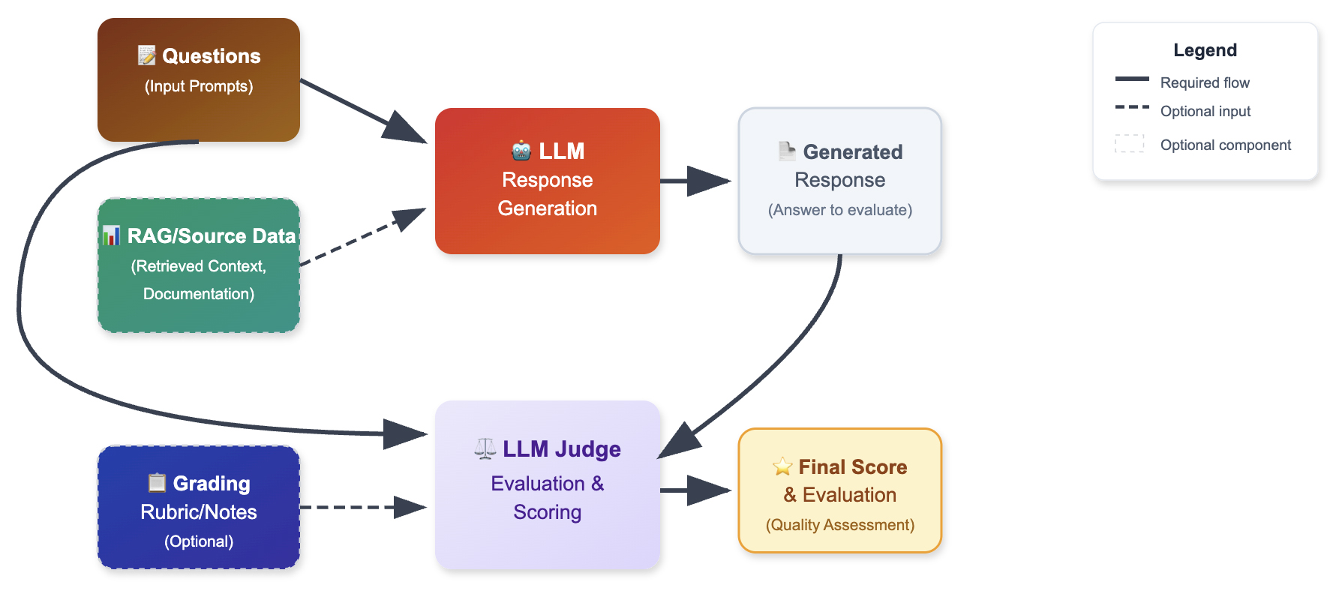
LLM as a Judge Architecture
Notes:
__

Slide 28
Best Practices
Use a clear prompt
Use a smaller grading scale or pass/fail
Avoid subjective decisions
Don’t self-grade
Iterate!
Validate with spot checks
Revisit regularly

Slide 29
Issues with LLM as a Judge
Can be too optimistic
Struggles with domain specific or cultural cues
Sensitive to small prompt variances
Judgments may vary slightly across identical inputs due to probabilistic nature of LLMs

Slide 30
Grading Notes
Tells the model what to look for
LLMs don’t “know” what you care about by default
Helps reduce randomness and bias – keeps the model focused on your task
Aligns more with a human grader
More upfront effort is required but makes judgments more repeatable
How to use:
Develop a comprehensive, multi-dimensional grading rubric
Create clear, objective scoring criteria
Define specific weight for each evaluation dimension
Establish a consistent scoring methodology
https://www.databricks.com/blog/enhancing-llm-as-a-judge-with-grading-notes

Slide 31
Frameworks aka Can’t Somebody Else Do This Stuff?

Slide 32
























An Expanding Ecosystem
Notes:
https://www.ianww.com/llm-tools#all-data

Slide 33
DEMO: LLM as a Judge with LangSmith

Slide 34
Use Case
A hospital wants an LLM to summarize lengthy clinician notes into concise, accurate versions
Another LLM (the judge) checks if the summary meets key standards (e.g., retaining critical info, using units) without dictating the exact wording
Dataset Structure
Input: A detailed clinical note with patient details, vitals, and observations
Output: Response from the LLM summarizing the Input
GradingNote: A rule to evaluate the summary (e.g., "Ensure vital signs include units" or "Ensure cardiac symptoms are mentioned")
GroundTruth: Boolean indicating whether output summary is correct

Slide 35
Sample Data
input | LLM _response | grading_note | grade
45-year-old female complains of shortness of breath. Vitals recorded: SpO2 100 %, RR 21 breaths/min. Respiratory distress suspected based on symptoms and history of asthma. Treated using albuterol nebulizer. | 45F with shortness of breath. Administered nebulizer. Vitals were: SpO2 100 %, RR 21 breaths/min. | Ensure the summary mentions nebulizer. | true
27-year-old male complains of palpitations and lightheadedness. Vitals recorded: SpO2 89 %, BP 100/70 mmHg, HR 71 bpm. Arrhythmia suspected based on symptoms and history of hypertension. Treated using 325 mg aspirin. | Patient had cardiac symptoms and was treated. | Ensure the summary mentions the patient's history of hypertension. | false

Slide 36
What You Need
A LangSmith account
Developer account is free for one user
https://www.langchain.com/pricing-langsmith
An LLM with an API key
Paid options – OpenAI, Anthropic, Mistral, xAI, DeepSeek
OR
Free API key for Google Gemini
https://aistudio.google.com/app/apikey
A dataset to evaluate (with or without grading notes)

Slide 37
Wrapping Up

Slide 38
Key Takeaways
A “good” answer is highly subjective
No one metric to rule them all
Humans are still the gold standard
Always ask ‘what are we optimizing for?’
Evaluation isn’t a one and done

Slide 39

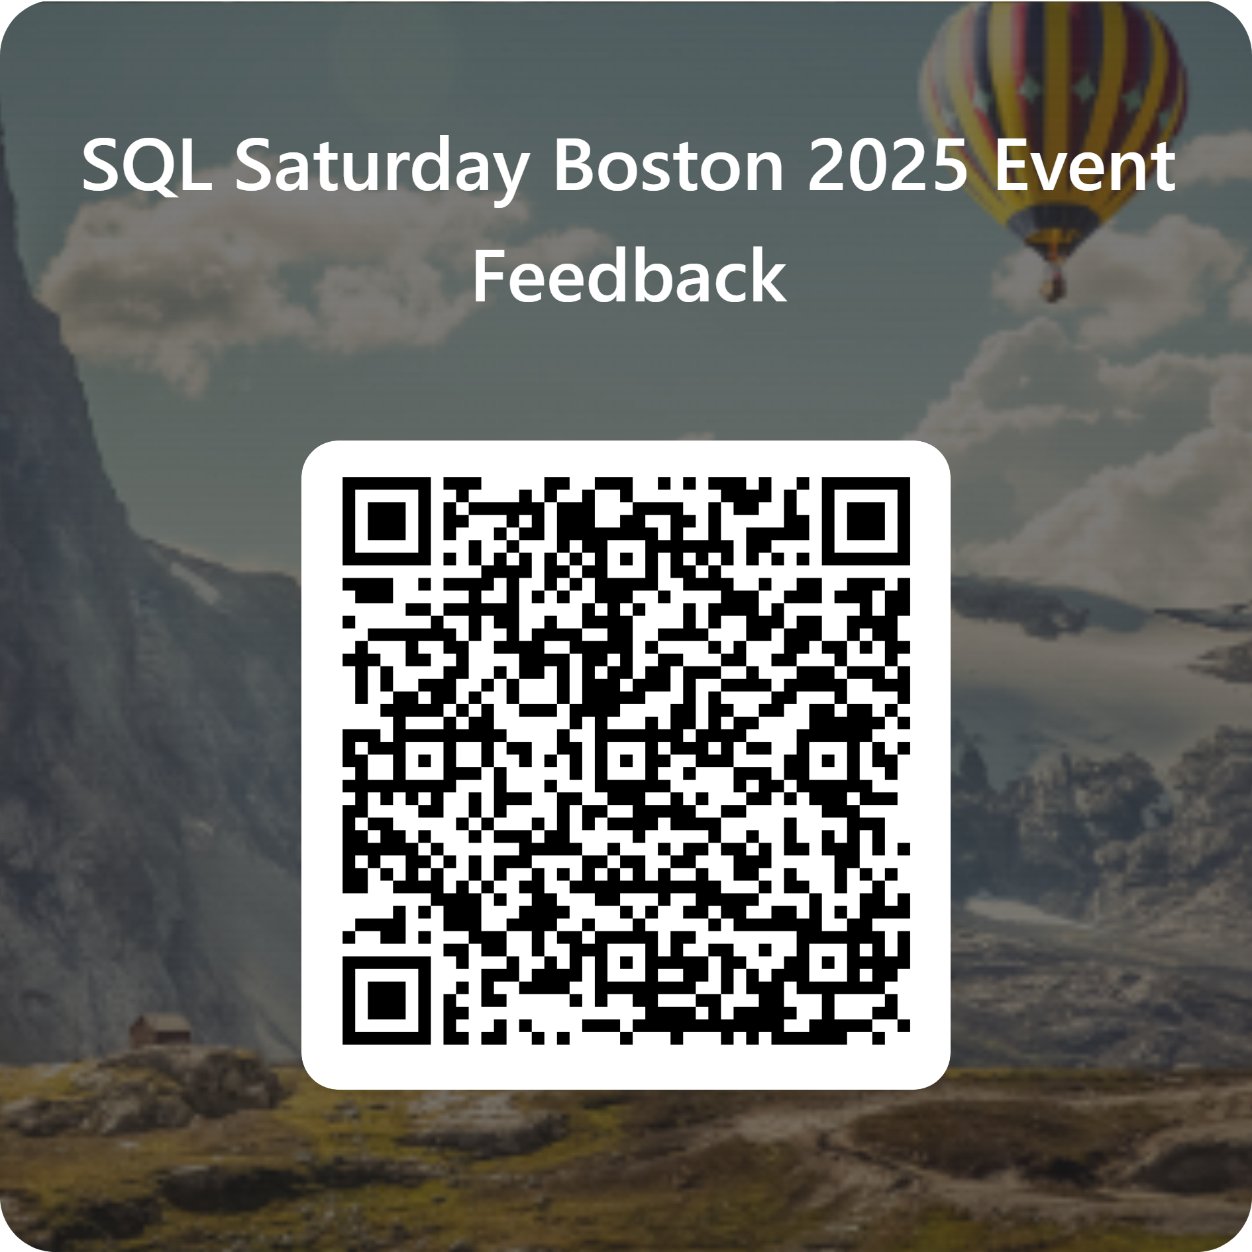
Session Evaluation Win 6x$50 gift card
Event Evaluation Win $100 gift card

Slide 40
Thanks! Questions?
Slides and sample data available at:
https://github.com/traceykroll/ChatGPTSaidWhat
You can fine me at:
Tracey@antrimsolutions.com
https://Linkedin.com/in/traceyakroll

